Slide 1
Decidable Languages

Slide 2


Recall that:
A language is Turing-Acceptable
if there is a Turing machine
that accepts
Also known as: Turing-Recognizable
or
Recursively-enumerable
languages

Slide 3



For any string :
halts in an accept state
halts in a non-accept state
or loops forever

Slide 4

Definition:
A language is decidable
if there is a Turing machine (decider)
which accepts
and halts on every input string
Also known as recursive languages

Slide 5
For any string :
halts in an accept state
halts in a non-accept state
Every decidable language is Turing-Acceptable

Slide 6
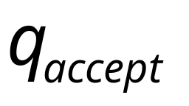
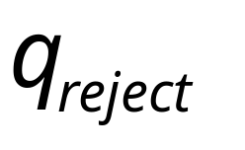
Sometimes, it is convenient to have Turing
machines with single accept and reject states
These are the only halting states
That result to possible
halting configurations

Slide 7



We can convert any Turing machine to
have single accept and reject states
New machine
Old machine
For each tape symbol
Multiple
accept states
One accept state

Slide 8



Do the following for each possible
halting state:
New machine
Old machine
For each
For all tape symbols
not used for read in the
other transitions of
Multiple
reject states
One reject state

Slide 9

For a decidable language :
Decision
On Halt:
Decider for
Accept
Input
string
Reject
For each input string, the computation
halts in the accept or reject state

Slide 10
For a Turing-Acceptable language :
Turing Machine for
Input
string
It is possible that for some input string
the machine enters an infinite loop

Slide 11

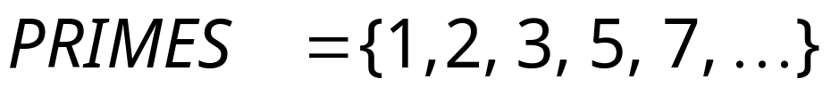
Problem:
Is number prime?
Corresponding language:
We will show it is decidable

Slide 12
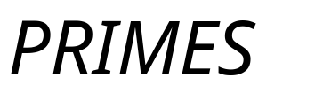
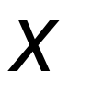
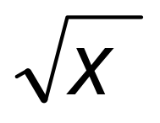

Decider for :
On input number :
Divide with all possible numbers
between and
If any of them divides
Then reject
Else accept

Slide 13
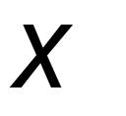
the decider for the language
solves the corresponding problem
Decider for PRIMES
YES
Input number
is prime?
(Accept)
(Input string)
NO
(Reject)

Slide 14



Theorem:
If a language is decidable,
then its complement is decidable too
Proof:
Build a Turing machine that
accepts and halts on every input string
( is decider for )

Slide 15



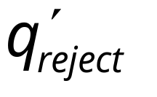
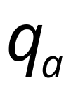

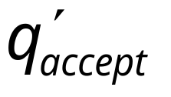

Transform accept state to reject
and vice-versa

Slide 16



Turing Machine
On each input string do:
1. Let be the decider for
2. Run with input string
If accepts then reject
If rejects then accept
Accepts and halts on every input string
END OF PROOF

Slide 17
Undecidable Languages
An undecidable language has no decider:
each Turing machine that accepts
does not halt on some input string
We will show that:
There is a language which is
Turing-Acceptable and undecidable

Slide 18
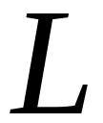
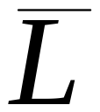
We will prove that there is a language :
is not Turing-acceptable
(not accepted by any Turing Machine)
is Turing-acceptable
the complement of a
decidable language is decidable
Therefore, is undecidable

Slide 19
Non Turing-Acceptable
Turing-Acceptable
Decidable

Slide 20
A Language which is not
Turing Acceptable

Slide 21
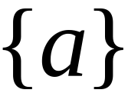
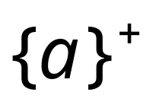

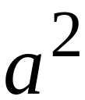
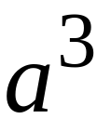
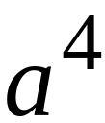
Consider alphabet
Strings of :

Slide 22
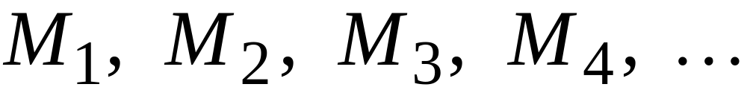
Consider Turing Machines
that accept languages over alphabet
They are countable:
(There is an enumerator that generates them)

Slide 23
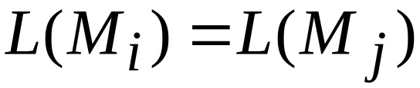

Each machine accepts some language over
Note that it is possible to have
for
Since, a language could be accepted by more than one
Turing machine

Slide 24
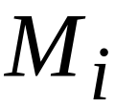
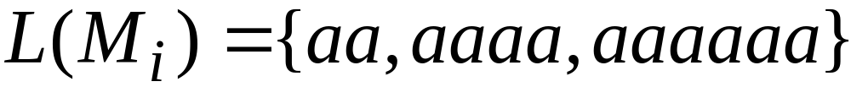
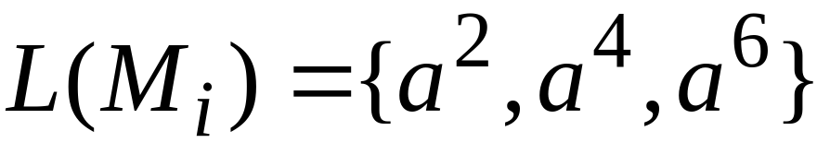







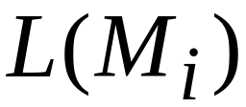


Example language accepted by
Binary representation

Slide 25
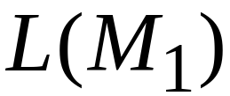
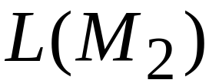
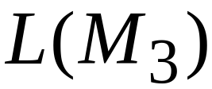
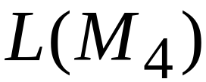
Example of binary representations

Slide 26
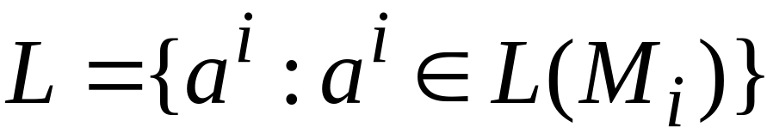
Consider the language
consists of the 1’s in the diagonal

Slide 27
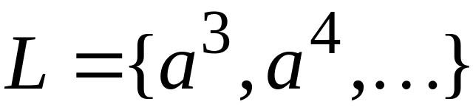

Slide 28

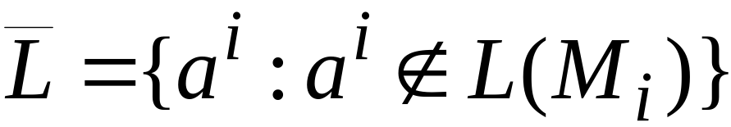

Consider the language
consists of the 0’s in the diagonal

Slide 29
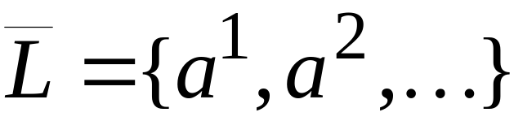

Slide 30
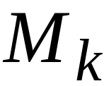
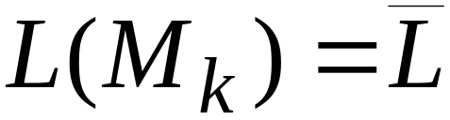
Theorem:
Language is not Turing-Acceptable
Proof:
Assume for contradiction that
is Turing-Acceptable
There must exist some machine
that accepts :

Slide 31
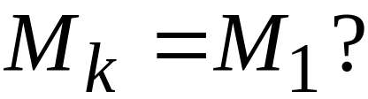
Question:

Slide 32
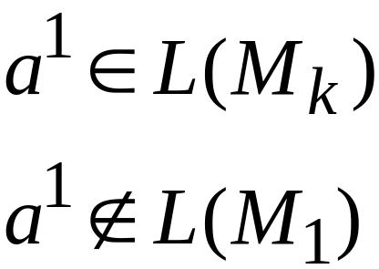
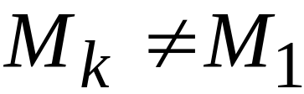
Answer:

Slide 33
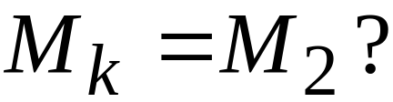
Question:

Slide 34
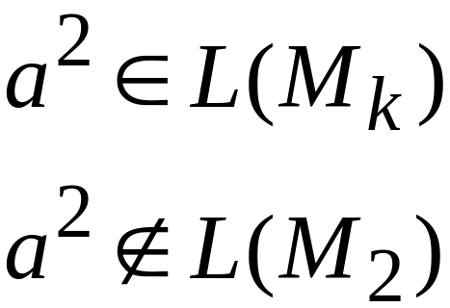
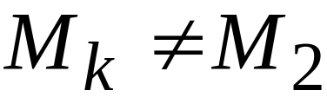
Answer:

Slide 35
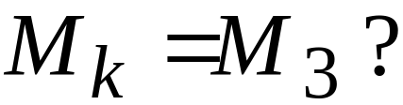
Question:

Slide 36
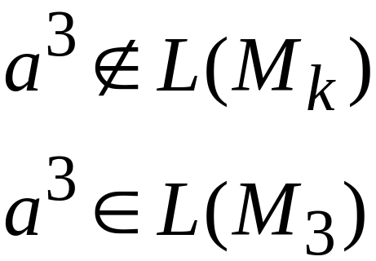
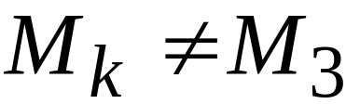
Answer:

Slide 37
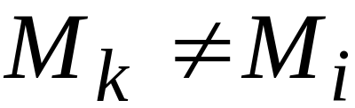

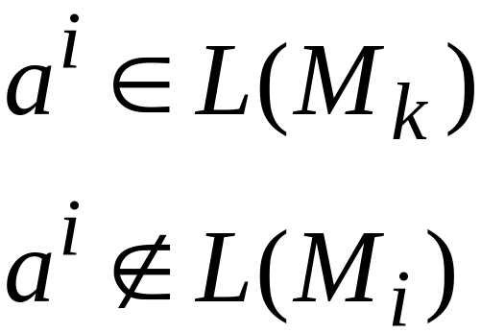
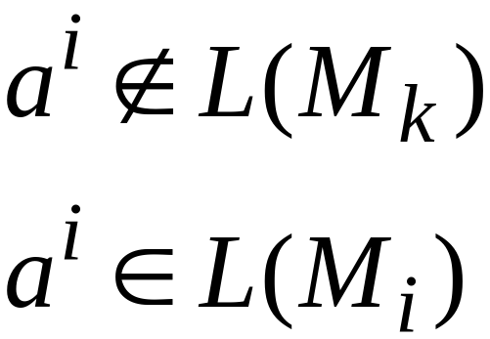
Similarly:
for any
Because either:
or
the machine cannot exist
is not Turing-Acceptable
End of Proof

Slide 38
Non Turing-Acceptable
Turing-Acceptable
Decidable

Slide 39
A Language which is
Turing-Acceptable and Undecidable

Slide 40
We will prove that the language
Is Turing-
Acceptable
Undecidable
There is a
Turing machine
that accepts
Each machine
that accepts
doesn’t halt
on some input string

Slide 42
Theorem:
The language
Is Turing-Acceptable
Proof:
We will give a Turing Machine that
accepts

Slide 43

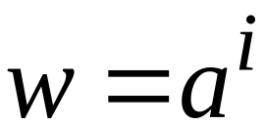

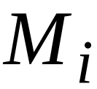

Turing Machine that accepts
For any input string
Compute , for which
Find Turing machine
(using the enumerator for Turing Machines)
Simulate on input
If accepts, then accept
End of Proof

Slide 44
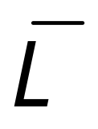
Observation:
Turing-Acceptable
Not Turing-acceptable
(Thus, is undecidable)

Slide 45
Non Turing-Acceptable
Turing-Acceptable
Decidable
?

Slide 46
Theorem:
is undecidable
Proof:
If is decidable
the complement of a
decidable language is decidable
Then is decidable
However, is not Turing-Acceptable!
Contradiction!!!!

Slide 47
Not Turing-Acceptable
Turing-Acceptable
Decidable

Slide 48
Turing acceptable languages and
Enumerators

Slide 49
We will prove:
(weak result)
If a language is decidable then
there is an enumerator for it
(strong result)
A language is Turing-acceptable
if and only if
there is an enumerator for it

Slide 50

Theorem:
if a language is decidable then
there is an enumerator for it
Proof:
Let be the decider for
Use to build the enumerator for

Slide 51





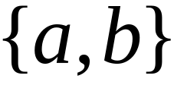




Let be an enumerator that prints
all strings from input alphabet in proper order
Example:
alphabet is
(proper order)

Slide 52
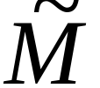
Enumerator for
Repeat:
1. generates a string
2. checks if
YES: print to output
NO: ignore
This part terminates,
because is decidable

Slide 53

Enumerator for
Give me
next string
Enumerates all
strings of
input alphabet
output
If accepts
then print to
output
string
All strings
of
Generates all
Strings in alphabet
Tests each string
if it is accepted by

Slide 54




Example:
Enumeration
Output
reject
accept
reject
accept
reject
accept
accept
reject
END OF PROOF

Slide 55
Theorem:
if language is Turing-Acceptable then
there is an enumerator for it
Proof:
Let be the Turing machine that accepts
Use to build the enumerator for

Slide 56

Enumerator for
Enumerates all
strings of input alphabet
in proper order
Accepts

Slide 57
NAIVE APPROACH
Enumerator for
Repeat:
generates a string
checks if
YES: print to output
NO: ignore
Problem:
If
machine may loop forever

Slide 58


BETTER APPROACH
Generates first string
executes first step on
Generates second string
executes first step on
second step on

Slide 59

Generates third string
executes first step on
second step on
third step on
And so on............

Slide 60

String:
1
1
1
1
Step in
computation
of string
2
2
2
2
3
3
3
3
4
4
4
4

Slide 61

If for any string
machine halts in an accepting state
then print on the output
End of Proof

Slide 62
Theorem:
If for language
there is an enumerator
then is Turing-Acceptable
Proof:
Using the enumerator for
we will build a Turing machine
that accepts

Slide 63
Input Tape
Turing Machine that accepts
Enumerator
for
Compare
If same,
Accept and Halt
Give me the
next string
in the
enumeration
sequence

Slide 64
Turing machine that accepts
For any input string
Loop:
Using the enumerator of ,
generate the next string of
Compare generated string with
If same, accept and exit loop
End of Proof

Slide 65
By combining the last two theorems,
we have proven:
A language is Turing-Acceptable
if and only if
there is an enumerator for it

